Slide 1
Employment Issues for PCNs
Julia Gray
Associate

Slide 2
Introduction
Integrated services require integrated staff
Several resultant employment law challenges but surmountable
To grapple with the challenges, essential to understand some employment law principles – refer to the Golden Rules

Slide 3
Golden Rules
Make sure a purported employer has legal standing: only a legal entity can be an employer
Beware of liability for employment claims: only an employer is liable in law for these claims (although contractual position might be different)
Factor-in possible redundancies: cessation of funding causing termination of a role usually will usually amount to a redundancy
Beware of creating a sham: a court or ET can see through an arrangement if the theory doesn’t reflect reality
Don’t forget to take staff with you - allow time for consultation

Slide 4
Key Employment Issues
Identity of employer
Recruitment processes
Work base and mobility across sites
Day to day management, including performance management
Payroll
VAT
Pensions
Disciplinary & grievance issues
Dismissal processes and liabilities
Redundancy liability
Liability for employment claims
Decision-making in respect of ALL of the above

Slide 5
Potential Employers of PCN Staff
Depends partly on the structure adopted
PCN (because not a legal entity)
All the PCN practices
One of the PCN practices
A third party
Structure does not determine employer
All models require detailed provisions re sharing of costs and liabilities

Slide 6
Potential Model: Flat Practice Network

Slide 7
Flat Practice Model – Key Staffing Issues
All practices sign up jointly to the network agreement
Staff could be recruited onto joint employment contracts – each practice regarded as joint employer OR employed by a single practice
One practice nominated as paymaster
Other responsibilities and liabilities shared across all members
One practice takes on HR obligations

Slide 8
Flat Practice Model – Pros and Cons
Pros | Cons
No pension issues envisaged | Certain issues will need to be carefully considered and robustly drafted e.g. - place of work - apportionment of staffing liabilities
No VAT issues envisaged | Risk of employment arrangement being deemed a sham if not what’s happening in reality

Slide 9
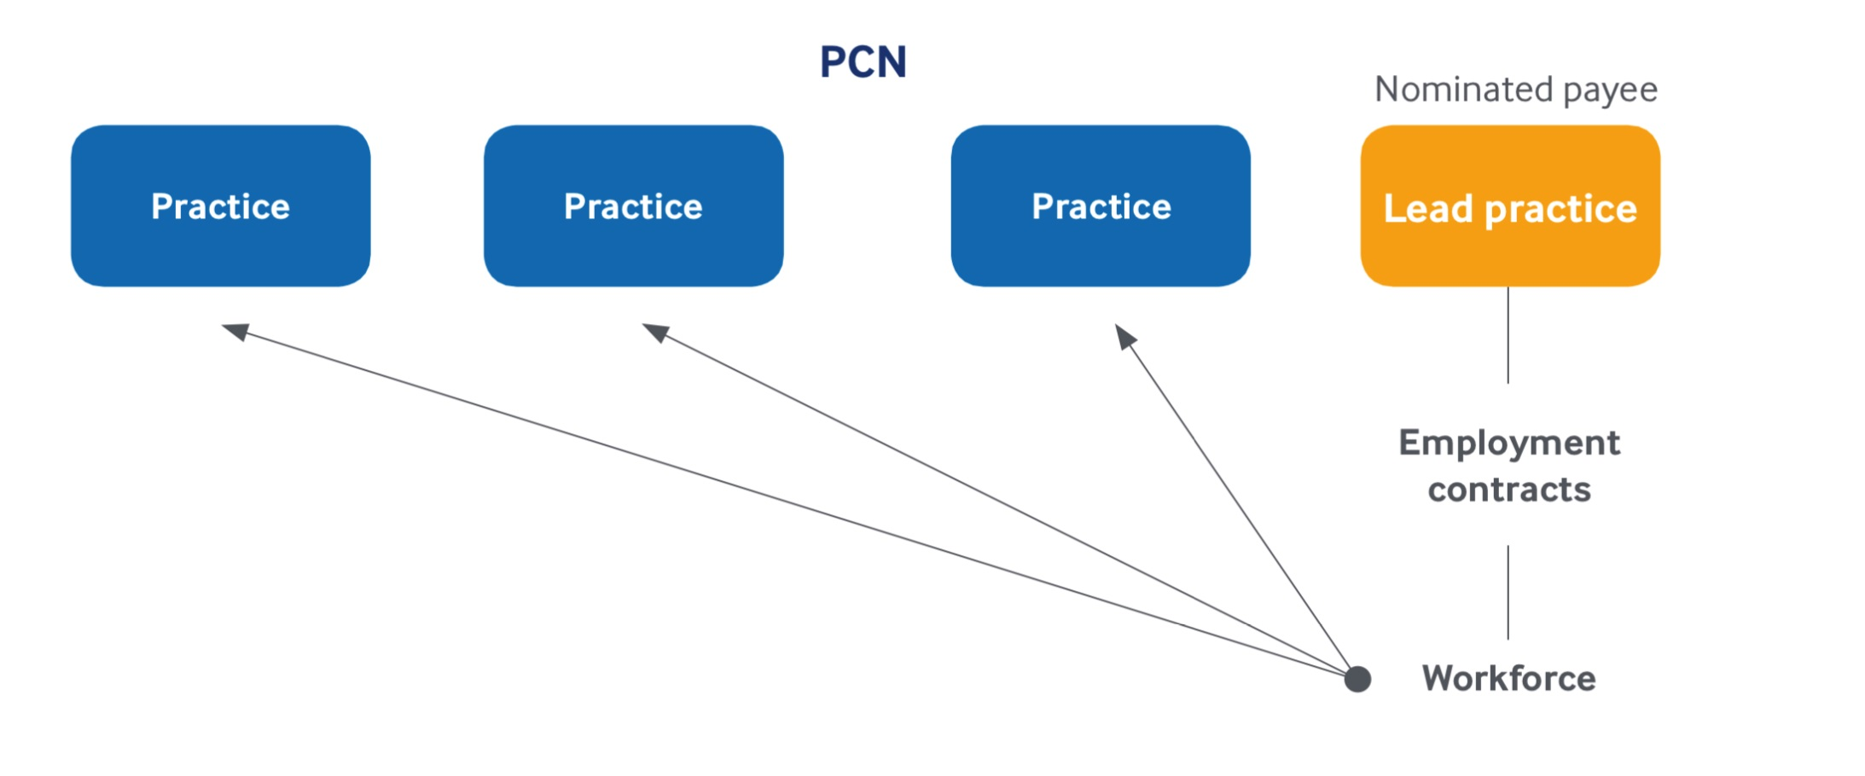
Potential Model: Lead Practice

Slide 10
Lead Practice Model – Key Staffing Issues
All practices sign up jointly to the network agreement
Network agreement records lead status for employment
Typically, a single practice employs PCN staff, acts as paymaster, assumes HR obligations
Other responsibilities and liabilities shared across network members
Staff might be seconded out to other practices or contractually required to work across whole network
Funding for staffing under DES sent direct to lead provider

Slide 11
Lead Practice Model – Pros and Cons
Pros | Cons
No pension issues envisaged | Complex secondment arrangements
Single employer = simpler employment model | Scope for confusion/dispute re “place of work”
 | Possible VAT issues if secondment deemed to be supply of staff

Slide 12
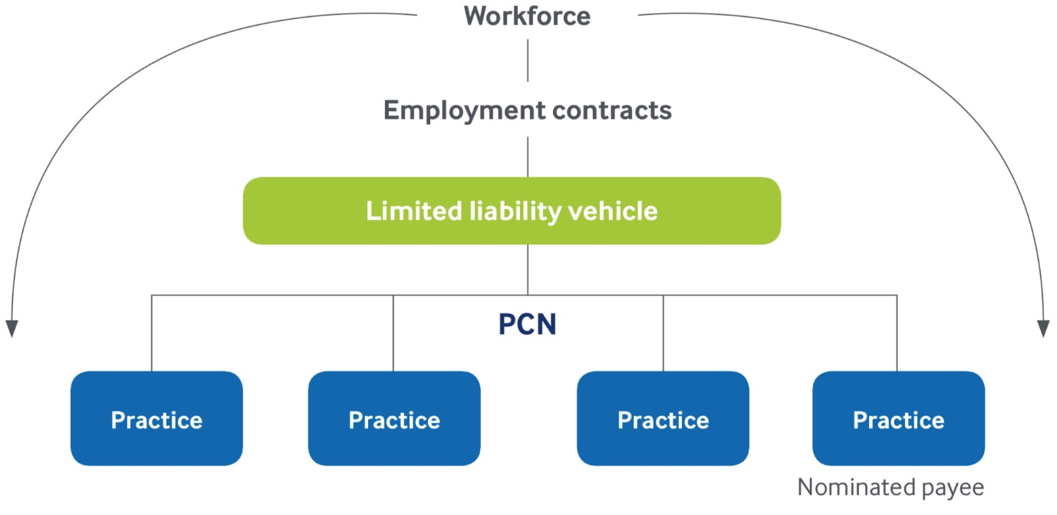
Potential Model: Third Party Provider Models
Third party could be a limited liability vehicle or an acute NHS trust

Slide 13
Third Party Models – Key Staffing Issues
Various models available including involving GP Federation, NHS Trust or limited liability vehicle
Pros | Cons
If the DES is outsourced, no employment liabilities | Staff may be unable to access NHS pension
Might be able to rely on larger, more experienced provider | Possible VAT issues depending on service provided
 | Lack of control if provider removed from PCN
 | Possible Agency Regulations issues

Slide 14
Contractual Issues
What contractual terms to use?
What policies will apply? Consider implications of a line manager manging PCN staff on terms/policies with which they are unfamiliar
Consider impact of PCN staff working alongside other practice staff who have different terms and conditions / benefits
Potential for redundancy or SOSR
Potential for transfers under TUPE
Data sharing & KPIs

Slide 15
Indemnities
Schedules to network agreement should contain indemnities
Don’t underestimate potential cost of employment liabilities
Indemnities will help to share those liabilities “fairly”
Commonly cover cost of court awards and legal costs
Redundancy (especially connected to withdrawal of funding) should also be covered
Consider variety of circumstances that could trigger indemnities
Consider including officers and agents as well as employees

Slide 16
Case Study - Anthea
Clinical pharmacist
Recruited and employed jointly by three constituent practices of PCN – practices A, B and C
Performance concerns come to a head after 18 months
Not handled pro-actively by line manager – practice manager of A
Heavy-handed performance review by practice manager of B who is lacks resource to conduct the process
Anthea accuses A and B of harassment and goes on long-term sick leave
Absence management process by practice manager C results in a dismissal
ET claim ensues and in judgement is that the dismissal was procedurally unfair and tainted by discriminatory treatment by practices A and B

Slide 17
Final Thoughts
Staffing considerations central to structural considerations
Issues are complex and will require specialist bespoke advice
Problems not insurmountable, but factor in time to:
work through them with your advisors and then
consult with existing staff
Well-drafted network agreement will be key to establishing relationships and liabilities and avoiding dispute later

Slide 18
Contact details
Julia Gray, Associate
T: 01423 724106
M: 07713 395836
E: j.gray@hempsons.co.uk
: @hempsonshr

